Slide 1
risk mitigation mechanism tool for disaster Preparedness and relief
KUNTAL CHAKRABORTY (698772)
RAHUL SAHA (434520)
ANIRUDDHA BOSE (179041)
JOYDEEP MUKHERJEE (774759)

Slide 2
The Problem
What is the problem?
Who has this problem?
Disaster affected lives
Why should this problem be solved?
Save life of evacuees
How will I know this problem has been solved?
Reduction in death toll
Inorganized & unoptimized disaster preparedness and volunteering activities
Unorganized and ill equipped volunteers
Provide timely guidance and support
Availability of sufficient relief aids

Slide 3
Background Information
We researched on multiple use cases that will address problem of multiple natural disasters and to focus a particular disaster management area.
When we brainstorm to identify some area where we can contribute in the various phases of Disaster Management - forecast/prediction, preparedness, evacuation, relief aid distribution and reconstruction. We discover this problem.
Latest technology with satellite and GIS system are working significantly well in forecasting and prediction. Based on our research and study we have identified that human being and animals are massively impacted during the time of evacuation and timely supply of relief materials like water, food, clothes and medicines are badly impacted. Communication and known routes are disrupted and easily reachable routes turns distinct.
Articles – Databases and Statistics for Disaster Risk Management (Author - Sreeja S.Nair, Anil K. Gupta, Klaus Roder; Body – NIDM, GIZ)
Articles – Chennai Floods 2015 A Rapid Assessment (Team of IIT Madras, IIT Mumbai & IISc Bangalore)
http://www.scirp.org/journal/PaperInformation.aspx?PaperID=75958
https://www.indiawaterportal.org/articles/bihar-floods-causes-and-preventive-measures
https://data.gov.in/resources

Slide 4
Workable Solutions
Solution #1
Organizing the volunteers
Forming team with foreign and local volunteers with translator and key skills
Solution #2
Identifying the safe shelters and evacuating the evacuees
Suggesting of resources based on the populations
Solution #3
Deployment of team on the relief activities
Suggesting means of transport to reach the disaster zone
Providing necessary safety gears for their own safety
Providing optimal routes to be followed for evacuation avoiding crowd rush and panic
Suggesting optimal route
Identifying the relief materials based on the type of disaster
Continuous and uniform supply of resources and aid

Slide 5





Business flow diagram
P
Part# 1
Part# 2
Part# 3
Team vacancy
Alternate distributed route
Alternate distributed route
Dashboard
Team readiness
Dashboard
Dashboard
Impacted areas
Analytical Engine
Analytical Engine
Safe Shelters
Analytical Engine
Safe Shelters
Volunteers Survey/Login
Team Composition
Route impact
Delivery route
Database
Measure current impact
Forecast impact
Required Relief
Available Relief
Request Relief
Survey data
Disaster data
Route map
Life impact
population
population
population
Relief Collection Centre
geography
geography
geography

Slide 6
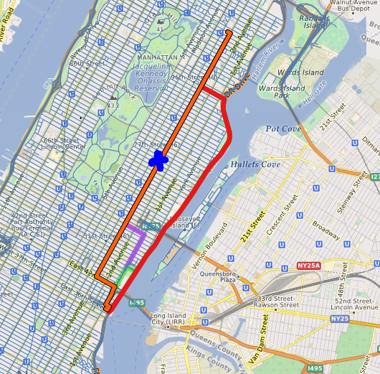

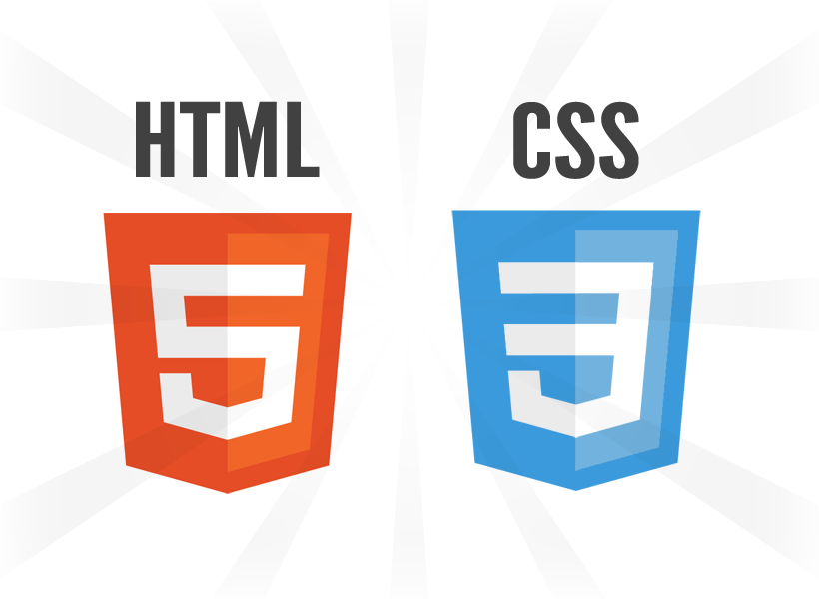












Technology to relief

Slide 7
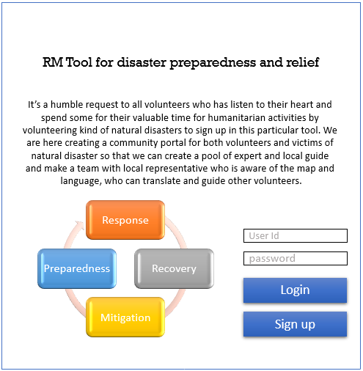
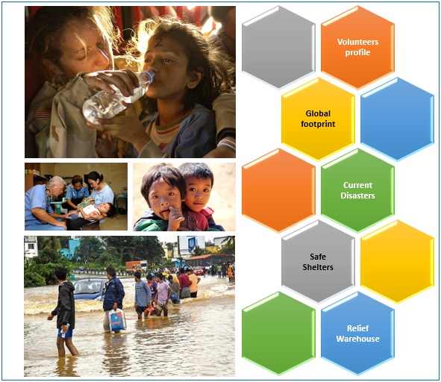
Solution# 1

Slide 8
Application data
S# | Title | Description
1 | Name | Info for addressing
2 | Address | For emergency communication, local guide
3 | DOB | Age
4 | Government ID | Identity
5 | Emergency Contract | For emergency communication
6 | Blood Group | For emergency communication, Blood Donor
7 | Education | For support that require education
8 | Previous Activities, Location | Previous knowledge of the risk and mitigation plan. Can be a Disaster SME.
9 | Primary Skills | How can one support or assist
10 | Secondary Skills | How can one support or assist
11 | Occupations | How can one support or network support
12 | Religion | Acceptance of community
13 | Language | For communication and local guide
14 | Gender | Acceptance of community
15 | Personal Contact | For communication and alert
All the information need to be stored in certain database
This shall assist to make a team and also monitor any vacancy in the team
This shall build a network of like minded humanitarian people
Team shall be well equipped as part of knowledge and strengths
Improve the productivity of the team
Reduce the risk of losing any members in the team and have continuous availability

Slide 9
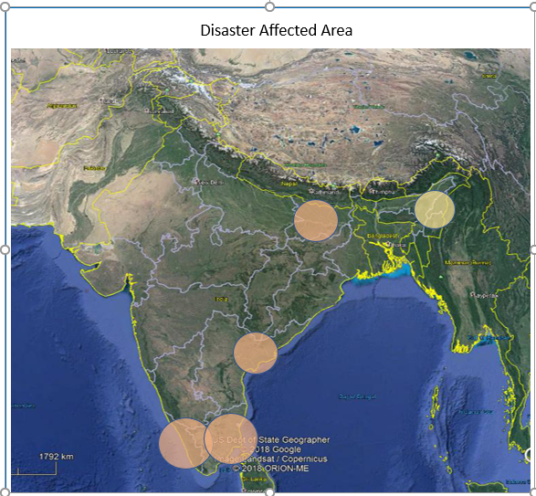
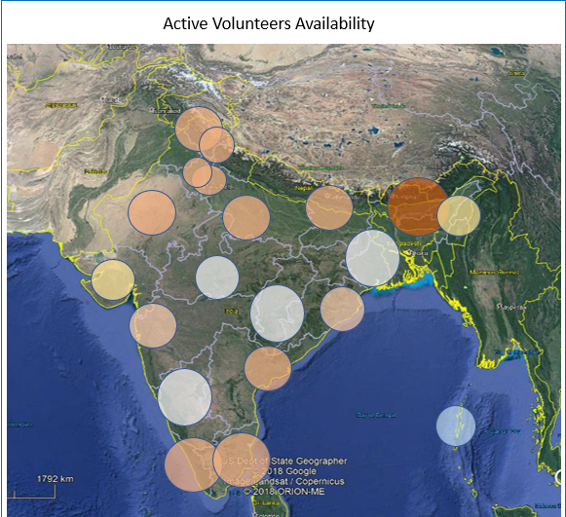
Solution# 2

Slide 10
Graphical representation
To know the area getting impacted through social media or MET department
Give an idea where volunteers are available for support
Alert volunteers and evacuees to be ready to move
Run the model based on solution# 1 to form team for support
Nos of Team deployed for support
Based on type of disaster, alert volunteers to take necessary gears for safety
Based on type of disaster, guide volunteers to gather necessary relief materials
Based on solution# 3, team and evacuees will get guidance to reach a safe location
Distribution of maps and on road broadcast/announcement can guide the evacuees

Slide 11
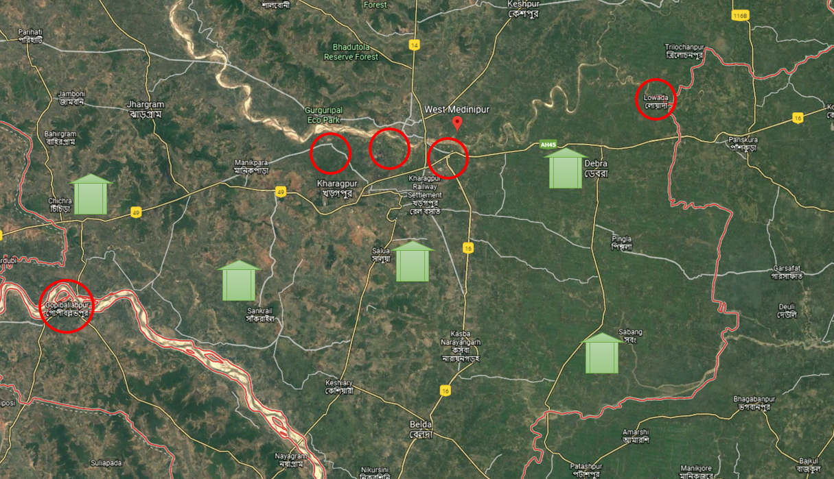
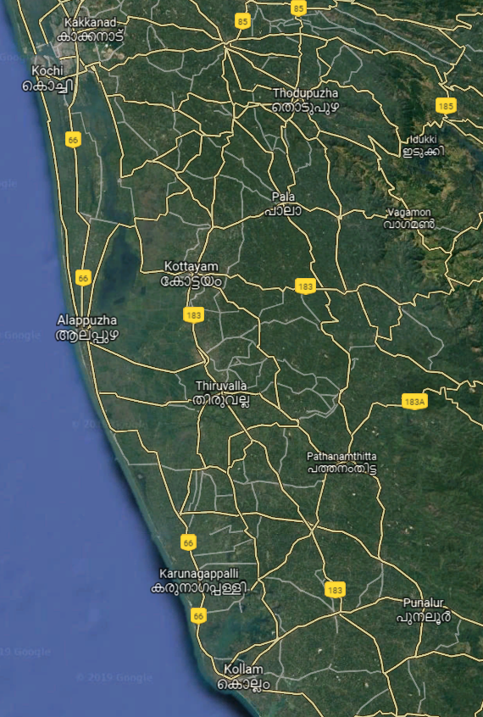
SOLUTION# 3
Location 1
Location 2

Slide 12
Model data from geospatial MAP
Demand and supply with the route distance between points
Disaster evacuees and Safe Shelter capacity with the route to reach
Similar approach to ensure sufficient volunteers are addressing an effected area
Supply → Demand ↓ |  | S-A | S-B | S-C | S-D | S-E | S-F | S-G
 |  | 800 | 700 | 1000 | 300 | 400 | 1100 | 800
D-1 | 1000 | 50km | 45km | 90km | 20km | 10km | 55km | 60km
D-2 | 1500 | 65km | 65km | 59km | 10km | 20km | 75km | 65km
D-3 | 2000 | 80km | 35km | 45km | 80km | 60km | 35km | 60km
D-4 | 1000 | 60km | 25km | 65km | 70km | 50km | 50km | 50km
D-5 | 800 | 40km | 30km | 70km | 20km | 10km | 45km | 40km

Slide 13
Technical aspect
Solution# 1 – It is an web based portal to store data of the volunteers. With all these data, we can build team with some mathematical models.
Solution# 2 – Data visualization and highlight the stats of availability of volunteers, team and impacted population. Alert vacancy in certain team based on solution# 1.
Solution# 3 – Generate an real-time optimal route for evacuation and supply of relief materials with some mathematical models.

Slide 14
Thank You

